Slide 1

Basic concepts of Cryptography.

Slide 2
Cryptography Introduction
Cryptography is a technique of securing communication by converting plain text into unintelligible cipher text. It involves various algorithms and protocols to ensure data confidentiality, integrity, authentication, and non-repudiation. The two primary types of cryptography are symmetric key cryptography and asymmetric key cryptography and It plays a vital role in ensuring the security and privacy of information in today’s digital world and enables secure online transactions, protects sensitive data stored in databases, and ensures the confidentiality of communication. As technology continues to advance, cryptography remains a crucial tool in the ongoing battle to keep our information safe from hackers.

Slide 3
Cryptographic Principles
Confidentiality refers to certain rules and guidelines usually executed under confidentiality agreements which ensure that the information is restricted to certain people or places.
Data integrity refers to maintaining and making sure that the data stays accurate and consistent over its entire life cycle.
Authentication is the process of making sure that the piece of data being claimed by the user belongs to it.
Non-repudiation refers to the ability to make sure that a person or a party associated with a contract or a communication cannot deny the authenticity of their signature over their document or the sending of a message.

Slide 4
Types of Cryptography
1. Symmetric-key cryptography: This type of cryptography involves the use of a single key to encrypt and decrypt data. Both the sender and receiver use the same key, which must be kept secret to maintain the security of the communication.
2. Asymmetric-key cryptography: Asymmetric-key cryptography, also known as public-key cryptography, uses a pair of keys – a public key and a private key – to encrypt and decrypt data. The public key is available to anyone, while the private key is kept secret by the owner.
3. Hash functions: A hash function is a mathematical algorithm that converts data of any size into a fixed-size output. Hash functions are often used to verify the integrity of data and ensure that it has not been tampered with.

Slide 5
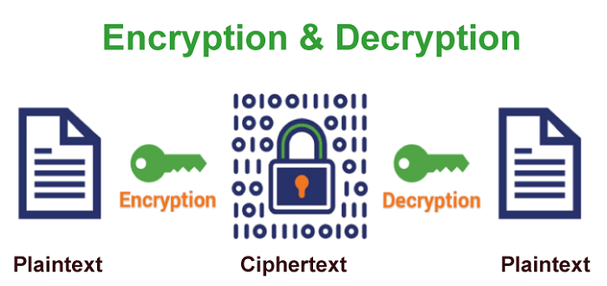
Encryption and Decryption
Cryptography involves two phases at its most fundamental level: Encryption and Decryption.
Encryption uses a cipher to encrypt and transform the plaintext into ciphertext. On the other hand, decryption transforms the ciphertext into plaintext by employing the same cipher.

Slide 6
Types of Cryptography Algorithm
Advanced Encryption Standard (AES): AES (Advanced Encryption Standard) is a popular encryption algorithm which uses the same key for encryption and decryption It is a symmetric block cipher algorithm with block size of 128 bits, 192 bits or 256 bits. AES algorithm is widely regarded as the replacement of DES (Data encryption standard) algorithm
Data Encryption Standard (DES): DES (Data encryption standard) is an older encryption algorithm that is used to convert 64-bit plaintext data into 48-bit encrypted ciphertext. It uses symmetric keys (which means same key for encryption and decryption). It is kind of old by today’s standard but can be used as a basic building block for learning newer encryption algorithms.
RSA: RSA is an basic asymmetric cryptographic algorithm which uses two different keys for encryption. The RSA algorithm works on a block cipher concept that converts plain text into cipher text and vice versa.
Secure Hash Algorithm (SHA): SHA is used to generate unique fixed-length digital fingerprints of input data known as hashes. SHA variations such as SHA-2 and SHA-3 are commonly used to ensure data integrity and authenticity. The tiniest change in input data drastically modifies the hash output, indicating a loss of integrity. Hashing is the process of storing key value pairs with the help of a hash function into a hash table.

Slide 7
Advantages of Cryptography
Access Control: Cryptography can be used for access control to ensure that only parties with the proper permissions have access to a resource. Only those with the correct decryption key can access the resource thanks to encryption.
Secure Communication: For secure online communication, cryptography is crucial. It offers secure mechanisms for transmitting private information like passwords, bank account numbers, and other sensitive data over the Internet.
Protection against attacks: Cryptography aids in the defense against various types of assaults, including replay and man-in-the-middle attacks. It offers strategies for spotting and stopping these assaults.
Compliance with legal requirements: Cryptography can assist firms in meeting a variety of legal requirements, including data protection and privacy legislation.

